Slide 1
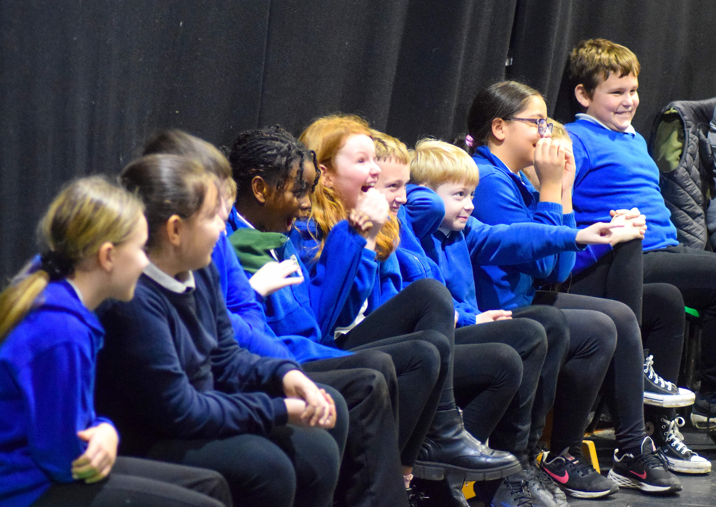

Useful Resources & Games
Preparing your child for school
Transition Links for website:
Support documents:
Being school-ready | PACEY
BBC Tiny Happy People
Best Ever - Holiday Activities and Food (HAF) Programme | Newcastle Support Directory
Autism Directory (padlet.com)
Resources for Parents - Foundation Years
Potty training: how to start & best age to potty train - ERIC
Supporting child’s wider development
What's On - Seven Stories | The National Centre for Children's Books
Search Results (greatnorthmuseum.org.uk)
Mathematics
Early Years Maths - Topmarks Search
BBC iPlayer - Numberblocks
Literacy
BBC iPlayer - CBeebies Bedtime Stories
BBC iPlayer - Alphablocks
Best Books for Reception: Ages 4-5 Recommended Booklist (booksfortopics.com)
Oxford Owl for School and Home
Parents and Carers - Ruth Miskin Literacy
Byker Primary School: Resilient, Respectful, Curious, Communicators

