Slide 1


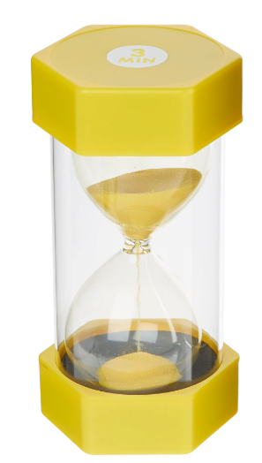
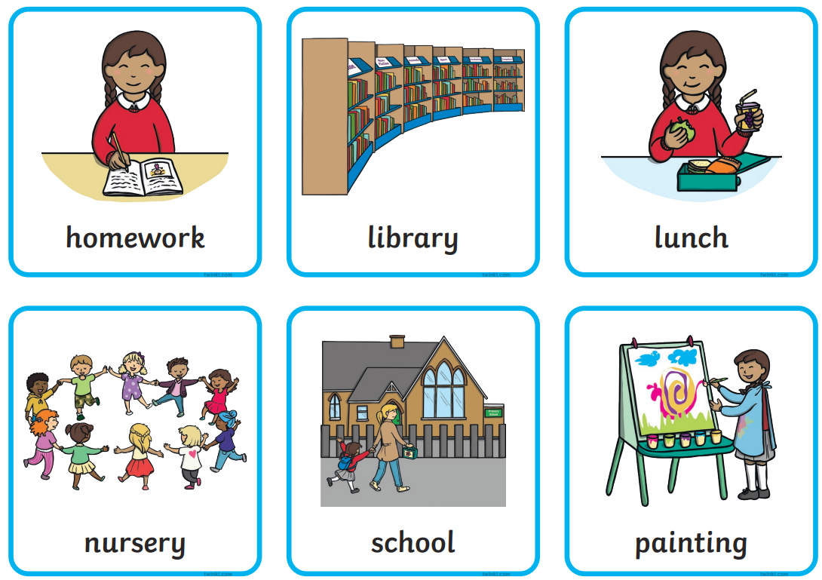
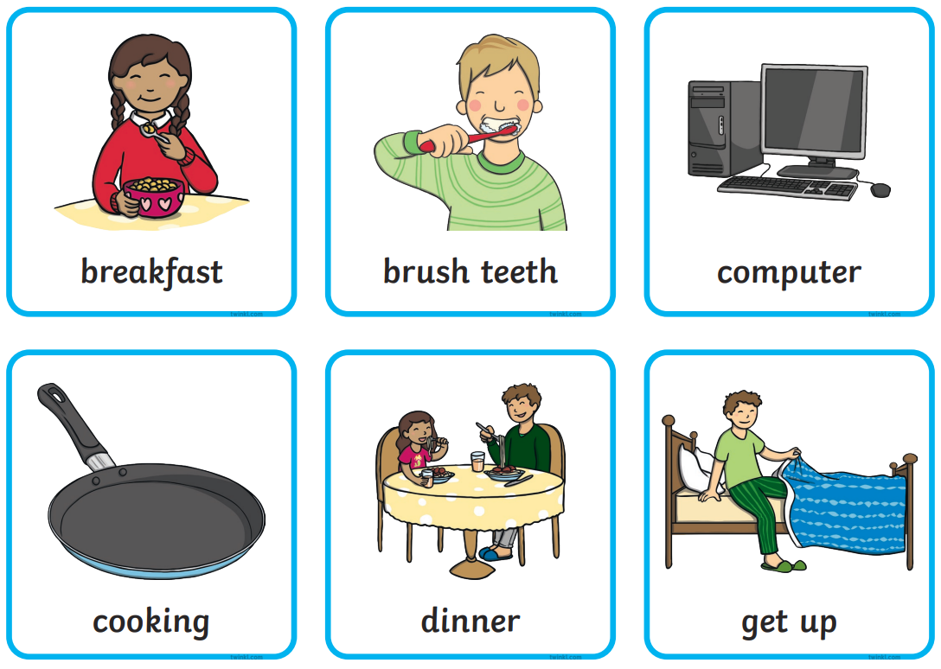
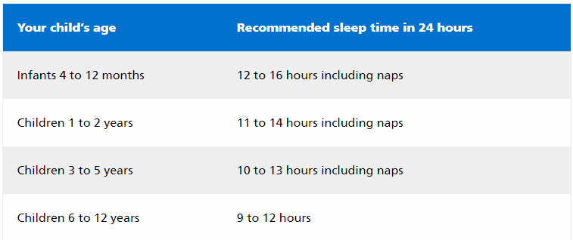

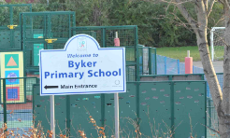
Routines
Consistent Routines are really important for children.
Over Summer establish a routine to prepare them for school.
Sleep hygiene in children and young people | Great Ormond Street Hospital (gosh.nhs.uk)
Visuals and timers can support with preparation for starting school.
Practice the journey to school to familiarise your child.
Good sleep hygiene begins in the day - Limit sugar intake and fizzy drinks.
Eating a large meal before bedtime can prevent sleep.
Children may have difficulty falling asleep if they have not been active in the day.
Limit use of devices before bed
Having a bedtime routine and a set bedtime
A routine can begin 30 minutes to two hours before bedtime
Going to the toilet as the last task before getting into bed
Early years oral health - the problems and solutions | PACEY
Byker Primary School: Resilient, Respectful, Curious, Communicators

