Slide 1
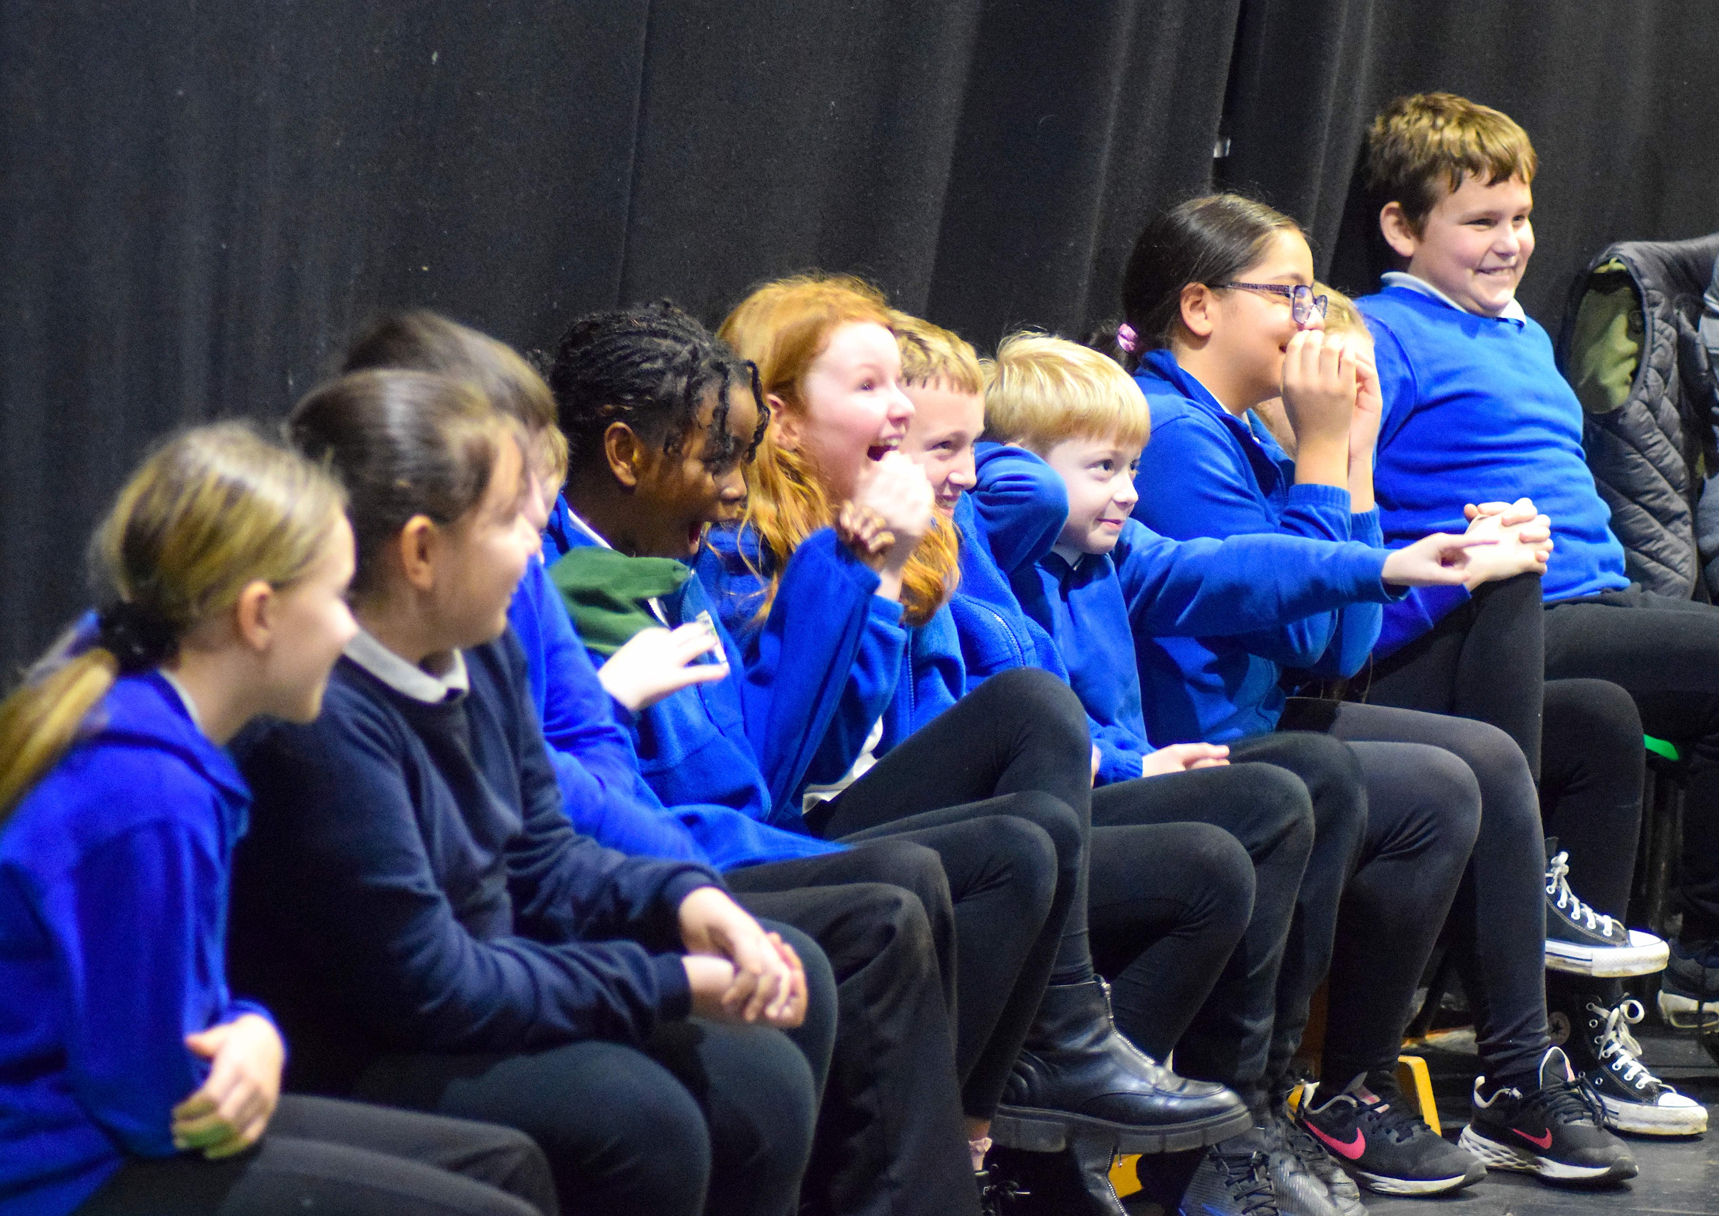

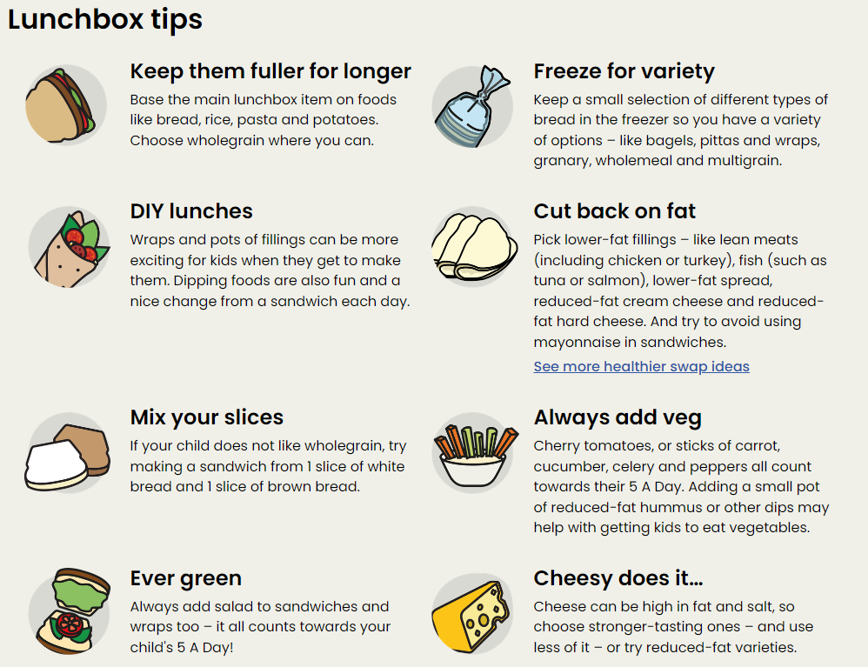
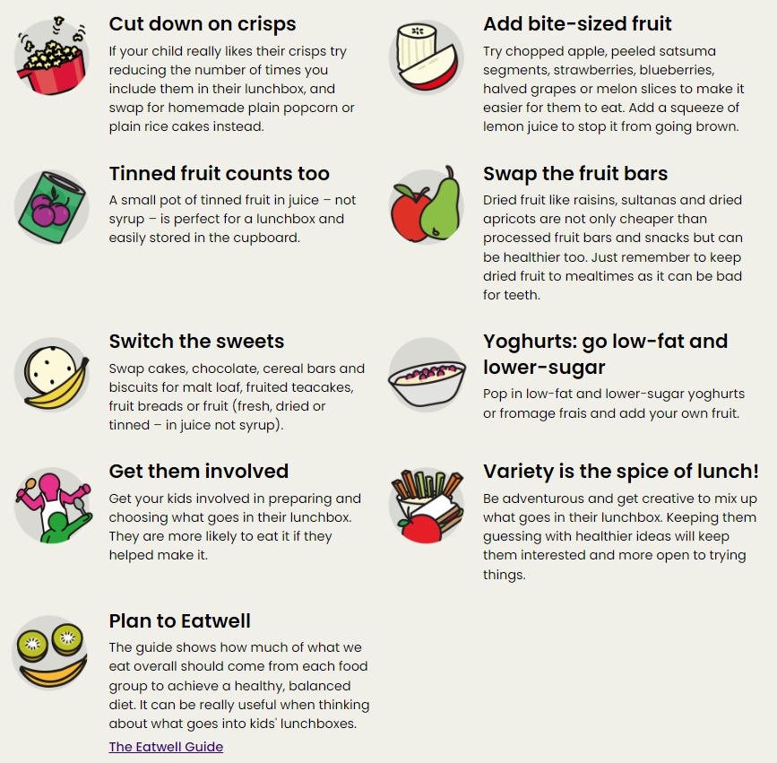
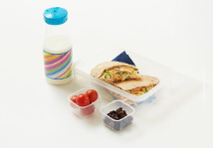
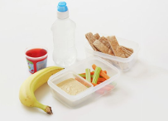


Healthy Eating & Physical Activities
3-5 Year olds need 3 hours daily of a variety of physical activities throughout the day.
These could include:
playing with blocks and other objects
messy play
jumping
walking
dancing
swimming
playground activities
climbing
skipping
active play, like hide and seek
throwing and catching
scooting
riding a bike
outdoor activities
The Eatwell Guide - NHS (www.nhs.uk)
Activities for kids - Healthier Families - NHS (www.nhs.uk)
Children under 5 should not be inactive for long periods, except when they're asleep. Watching TV, travelling by car, bus or train, or being strapped into a buggy for long periods are not good for a child's health and development.
Byker Primary School: Resilient, Respectful, Curious, Communicators

