Slide 1
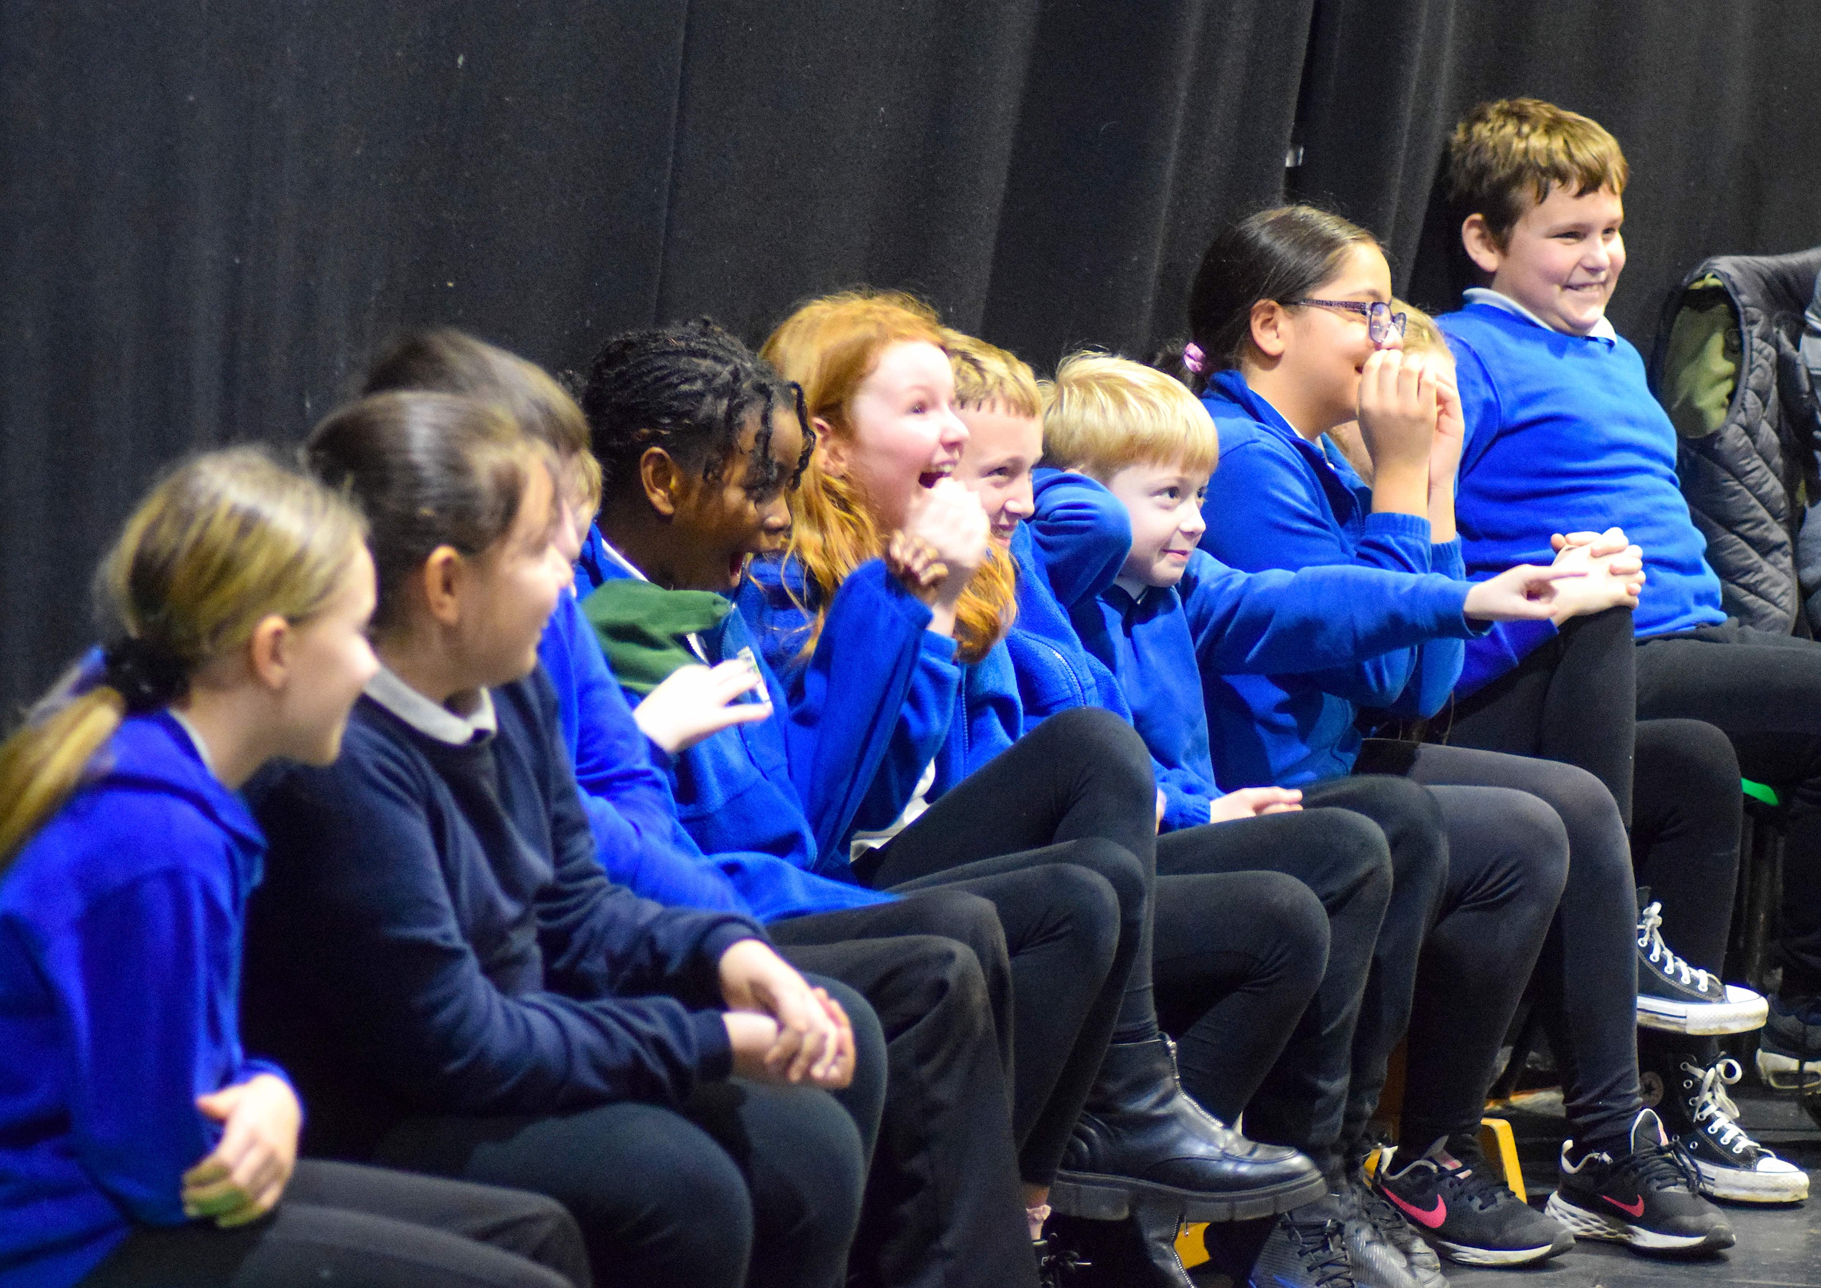

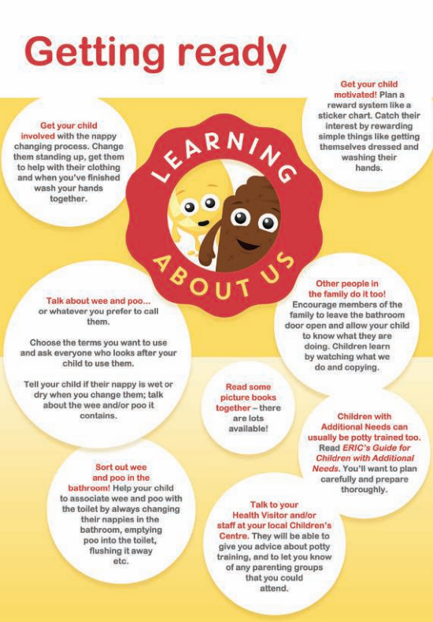

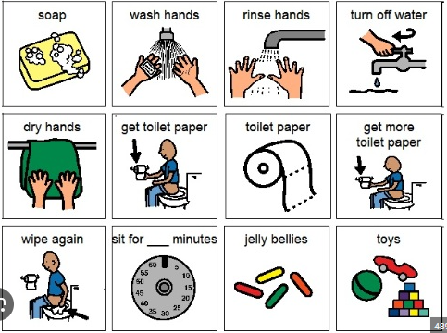

Toilet Training
During summer holidays support your child to be toilet trained ready for Nursery and Reception.
Children usually toilet train between 18 months – 3 years old.
Support them to understand the importance of hygiene.
Choose clothes that are easy for them to access the toilet in e.g joggers, poppers, zips.
Some children have anxiety around pooing in the toilet. Ready stories and access resources out there. A Wee and Poo Adventure Story - ERIC
Keep routines and show visuals.
Talk to us about how recent your child has become toilet trained. So we can support them in school.
Provide school with a change of clothes to keep in their draw.
Be consistent, build going to the toilet or potty into your routine, sitting them on the toilet.
Drinking 6-8 cups of water and going to the toilet 20-30 minutes after meal times.
Byker Primary School: Resilient, Respectful, Curious, Communicators

