Slide 1
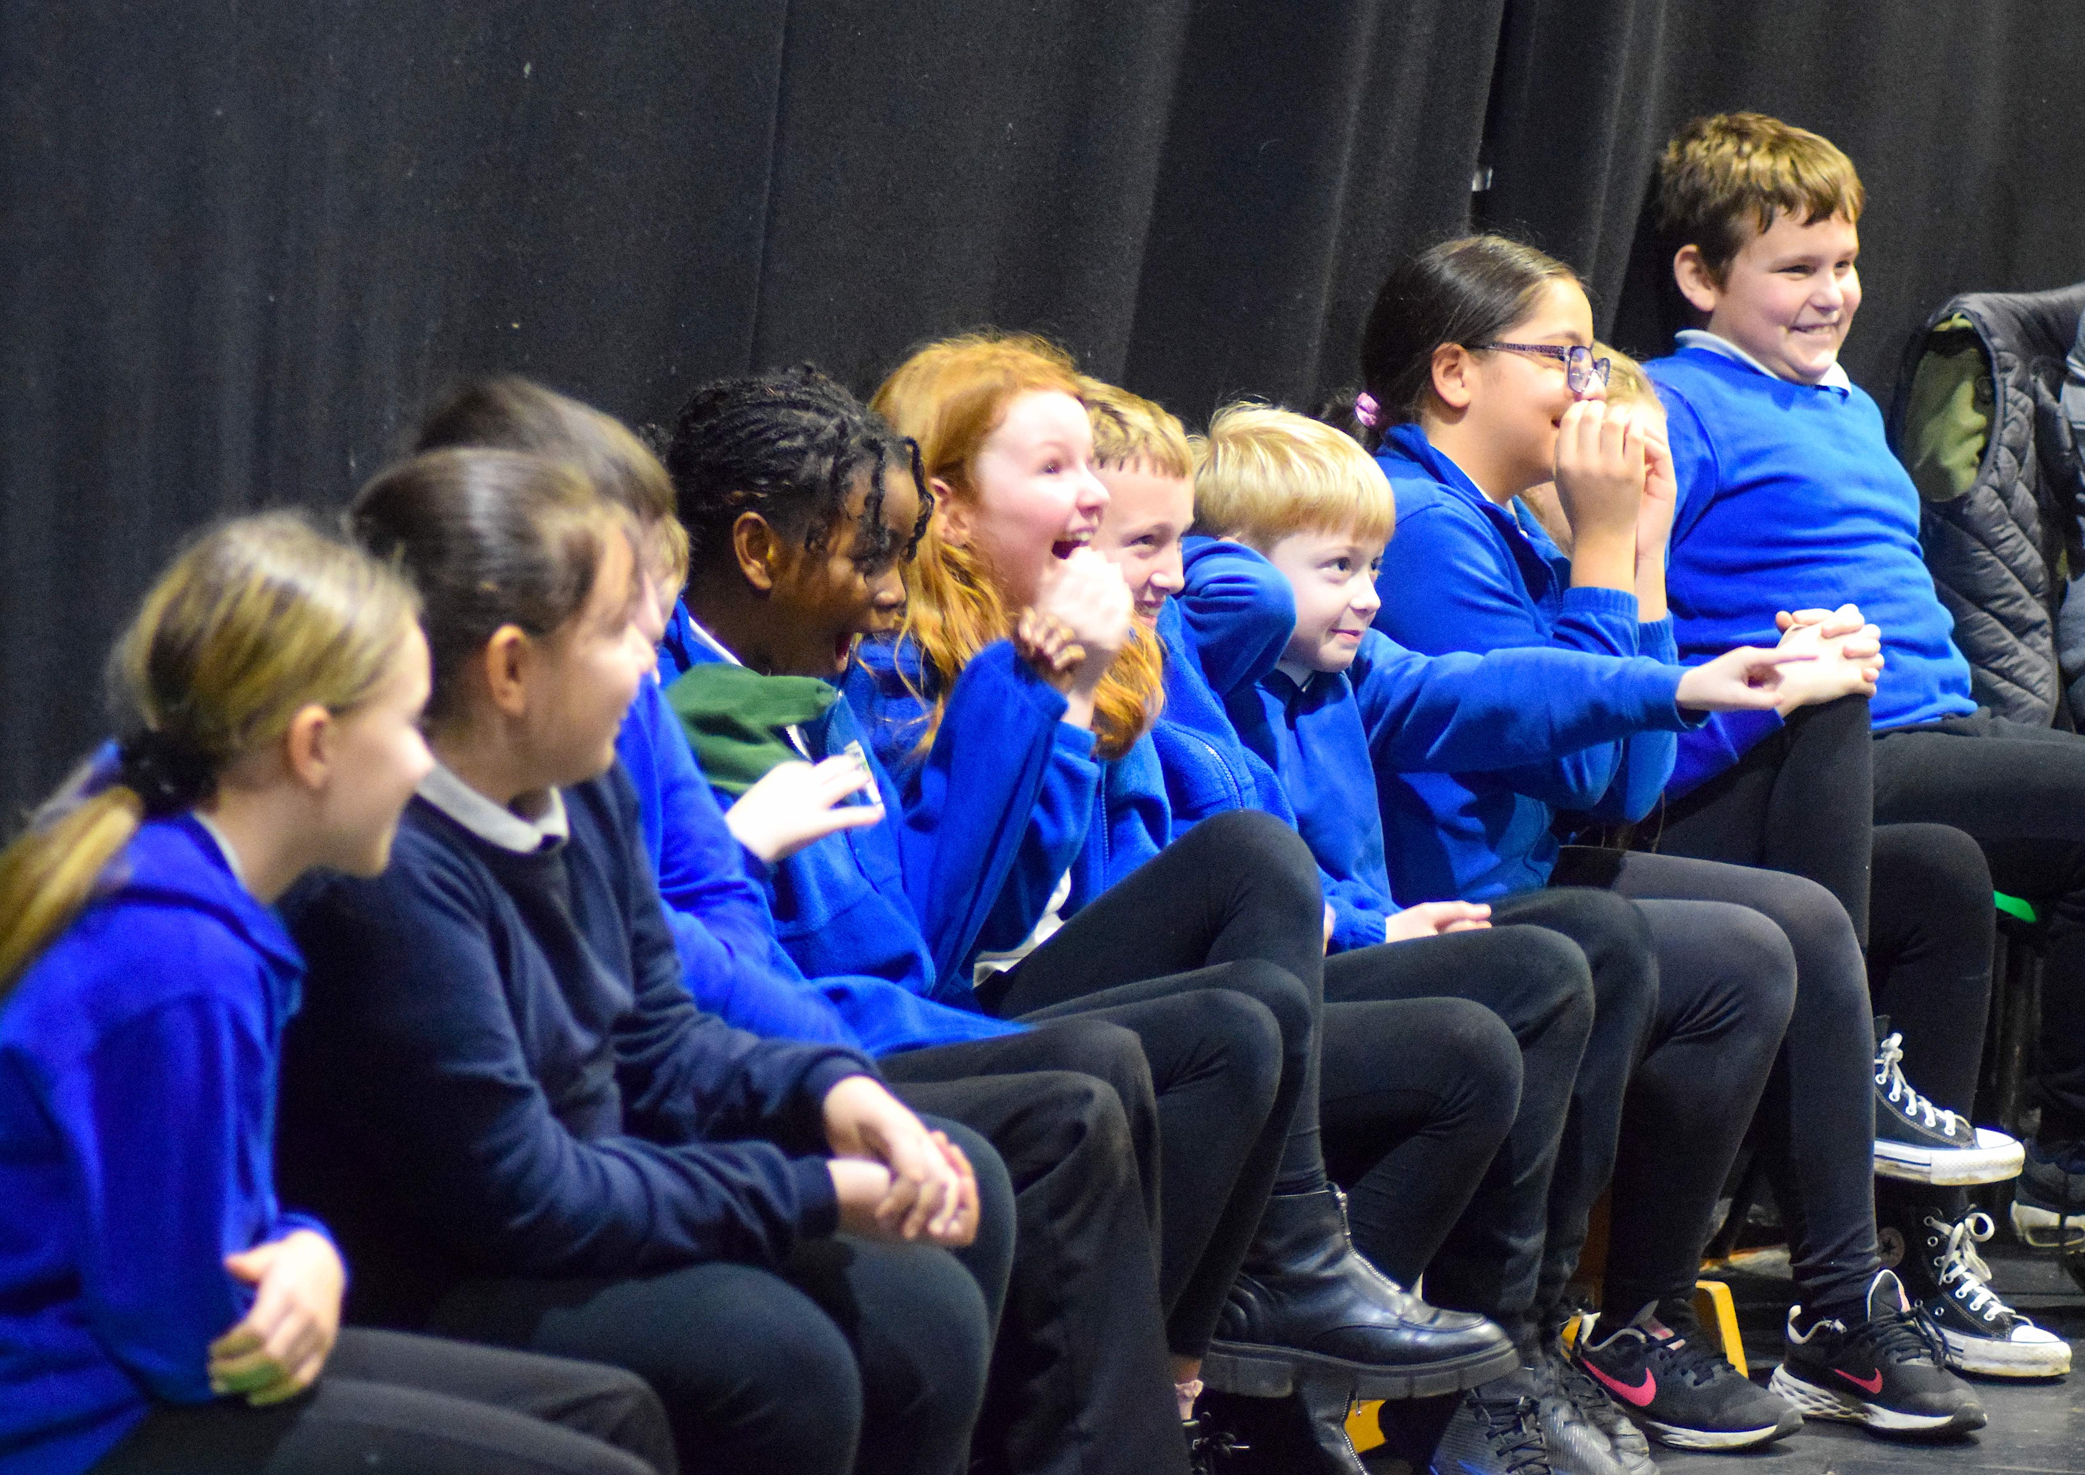

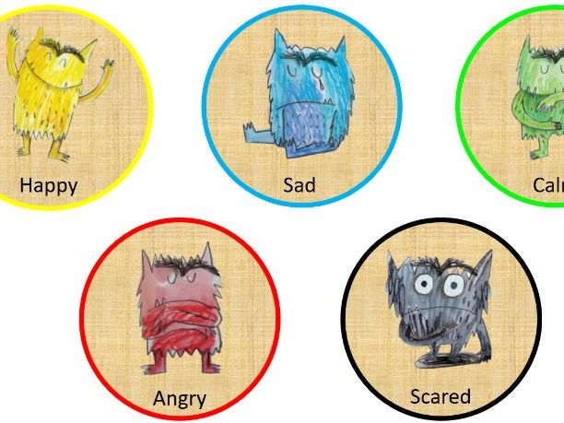
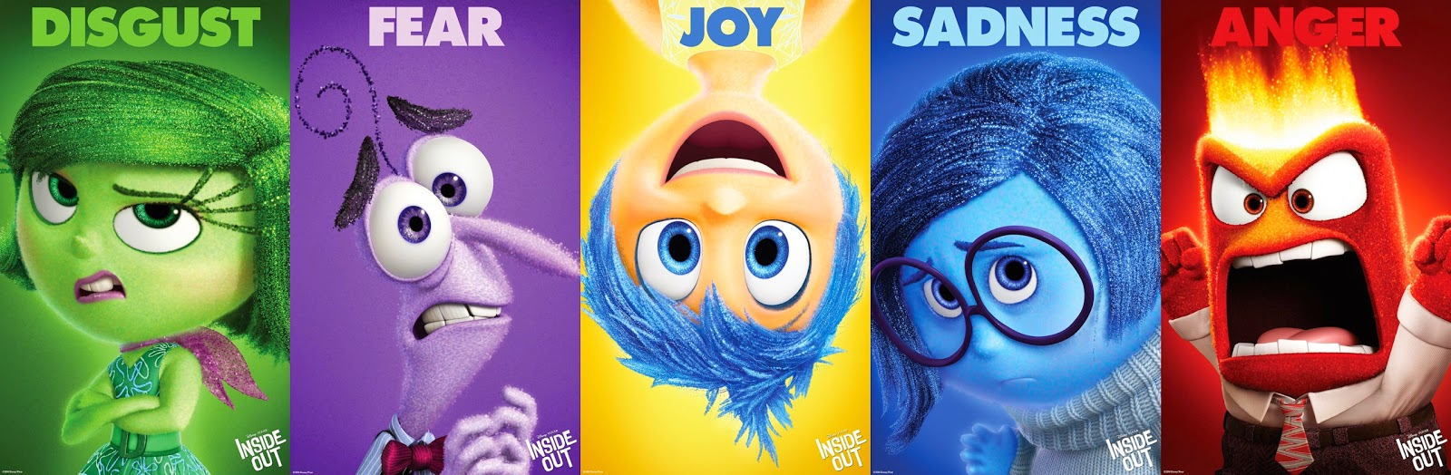
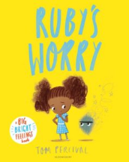
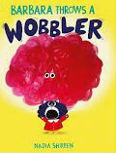
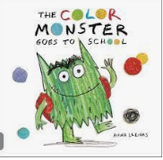
Communication & Mental Health
Tiny Happy People - Tips and advice for children's speech and language (bbc.co.uk)
Supporting Communication:
Get down to the child’s level: Get down to their level and talking and playing face to face.
Talk about the feelings we have, in our setting we use zones of regulation.
We refer to these characters and how we are feeling.
Get the child’s attention before talking: You can get the child’s attention by calling their name. Turn down the TV
Share stories
Use simple language and repeat words: Keep your sentences short(e.g. ‘Spade. That’s a spade. A green spade. Spades are for digging’).
Give choices
Add one word: . So if the child says ‘I got teddy’, you could say ‘Yes, you’ve got a fluffy teddy!’.
Sing songs
Support your child with strategies to regulate their emotions
i.E stomping, blowing bubbles, communicating their emotion.
Pausing: Pausing gives children extra time to think about what they want to say
and Nursery Rhymes
Follow their lead
in play
Use comments not testing questions: For example, if we comment ‘Wow I love this purple car’ the child might tell you about their favourite colour.
Activities for 3-4 years | Words for Life
Help your baby learn to talk - NHS (www.nhs.uk)
Byker Primary School: Resilient, Respectful, Curious, Communicators

